Slide 2
Reinforcement Learning
Lecture 3 - Approximation Methods

Slide 3
Course Agenda
Lecture 1
Introduction to Reinforcement Learning
Finite Markov Decision Process
Bellman Equations
Dynamic Programming
Lecture 2
Monte Carlo Methods
Temporal-Difference Learning
SARSA and Q-Learning
Lecture 3
On Policy Prediction and Control with Approximation
Off Policy Methods with Approximation
Lecture 4
Policy Gradient Methods
Lecture 5
Multi-armed Bandits

Slide 4
Lecture Topics
Lecture 3
Approximator Methodology Elements
Function Approximation Intuition
Value Function Approximation
Linear Approximator
High-order Approximators
Monte Carlo with Value Function Approximation
TD Learning with Value Function Approximation
Action Value Function Approximation

Slide 5
Demo Code
The DEMO notebook used for this lecture is available in your SageMaker instance, named as RL1_lecture_3_demo.ipynb, into demos folder
You will find each DEMO code in the notebook index:
Gradient Descent
MC Approximator
Multiple Tiles for Multiple Features
TD(0) Approximator

Slide 6
Function Approximation
Notes:
Let’s talk about Function Approximation.
A more compact representation that generalizes across states or states and actions, saving computation time and memory space

Slide 7
Last Lecture
Monte Carlo Methods (MC)
Ways of solving the reinforcement learning problem based on averaging sample returns
Sample sequences of states, actions, and rewards from actual or simulated interaction with an environment
Episodic updates
Temporal-Differencing Learning (TD)
Similar to Monte-Carlo methods, Temporal-Difference (TD) Learning is model-free and learns from episodes of experience
However, TD learning can learn from incomplete episodes and hence we don’t need to track the episode up to termination

Slide 8
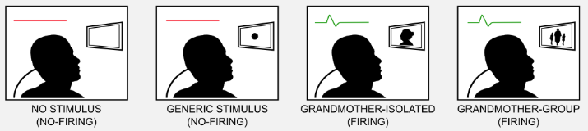
Approximators
Your brain is a powerful approximator:
We can consider the world as a huge and chaotic state-space, where the correct evaluation of a specific stimulus makes the difference between life and death
Local Representation (Grandmother Cell Theory*)
Let's suppose that our brain is a massive lookup table, which can store in a single neuron (or cell) a single state
A grandmother cell is a hypothetical neuron that responds only to a specific and meaningful stimulus, such as the image of one’s grandmother
Problem: lost of one cell means lost of information
* The term is due to the cognitive scientist Jerry Lettvin who used it to illustrate the inconsistency of the concept during a lecture at MIT

Slide 9


Approximators
Distributed Representation
The information is stored in a distributed way, and that each single concept is represented through a pattern of activity
Having N cells it is possible to represent more than N states
Computer Keyboard Example
In the local representation each single key can codify only a single character
In the distributed representation we can use a combination of keys (e.g. Shift and Ctrl) to associate multiple characters to the same key
X

Slide 10
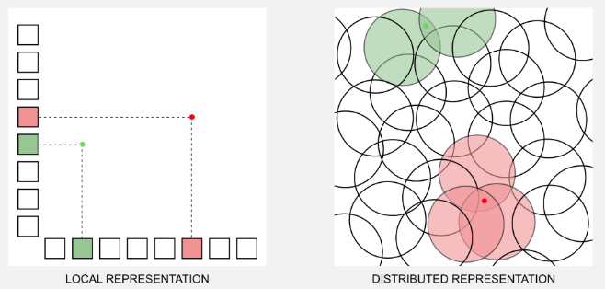
Approximators
Distributed x Local Representation
The local scheme is represented as a two dimensional grid, where it is always necessary to have two active units to codify a stimulus
The distributed representation as an overlapping between radial units
We need less parameters that the number of states to represent the states in our environment!

Slide 11
Approximators
Distributed Representation
From a machine learning perspective we know that the distributed representation works
The success of deep learning is based on neural networks, which are powerful function approximators
Let’s see how a distributed representation can solve the problems due to local representation in Reinforcement Learning

Slide 12
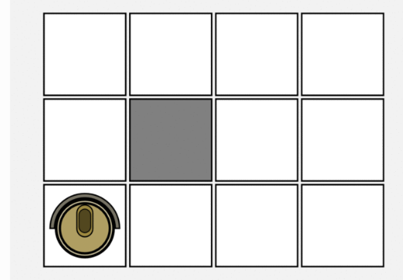
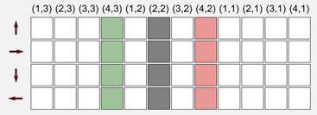
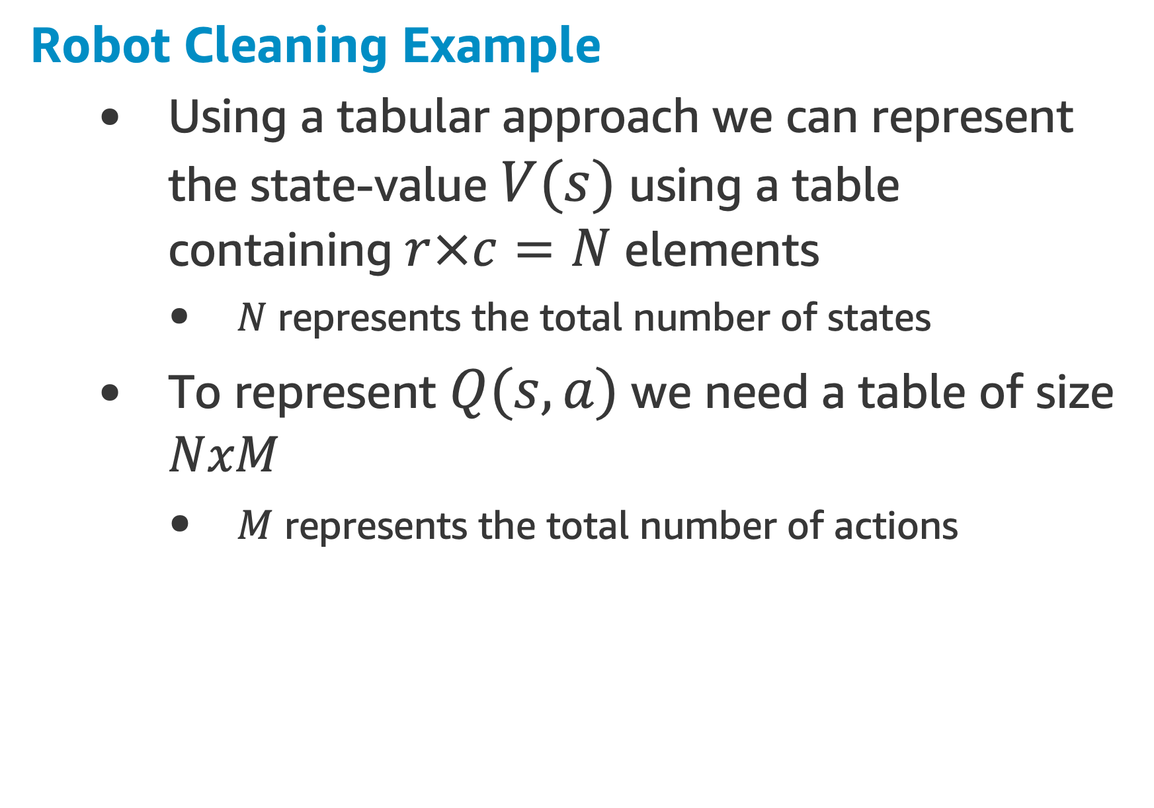
Function Approximation Intuition
Robot Cleaning Example
Using a tabular approach we can represent the state-value $V(s)$ using a table containing $r×c=N$ elements
$N$ represents the total number of states
To represent $Q(s,a)$ we need a table of size $NxM$
$M$ represents the total number of actions

Slide 13
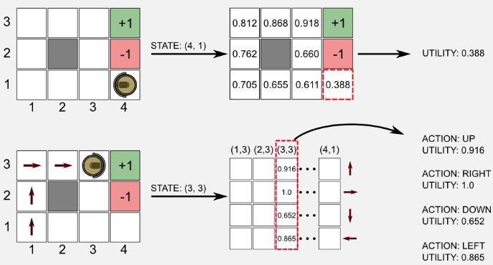
Function Approximation Intuition
Robot Cleaning Example
To get the state-value we have to access the location of the matrix corresponding to the particular state where we are
To get the action-value, we use the state as index, to access the column in the state-action matrix and from that column we return the action-value of all the available actions

Slide 14
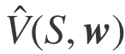
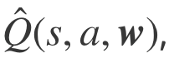
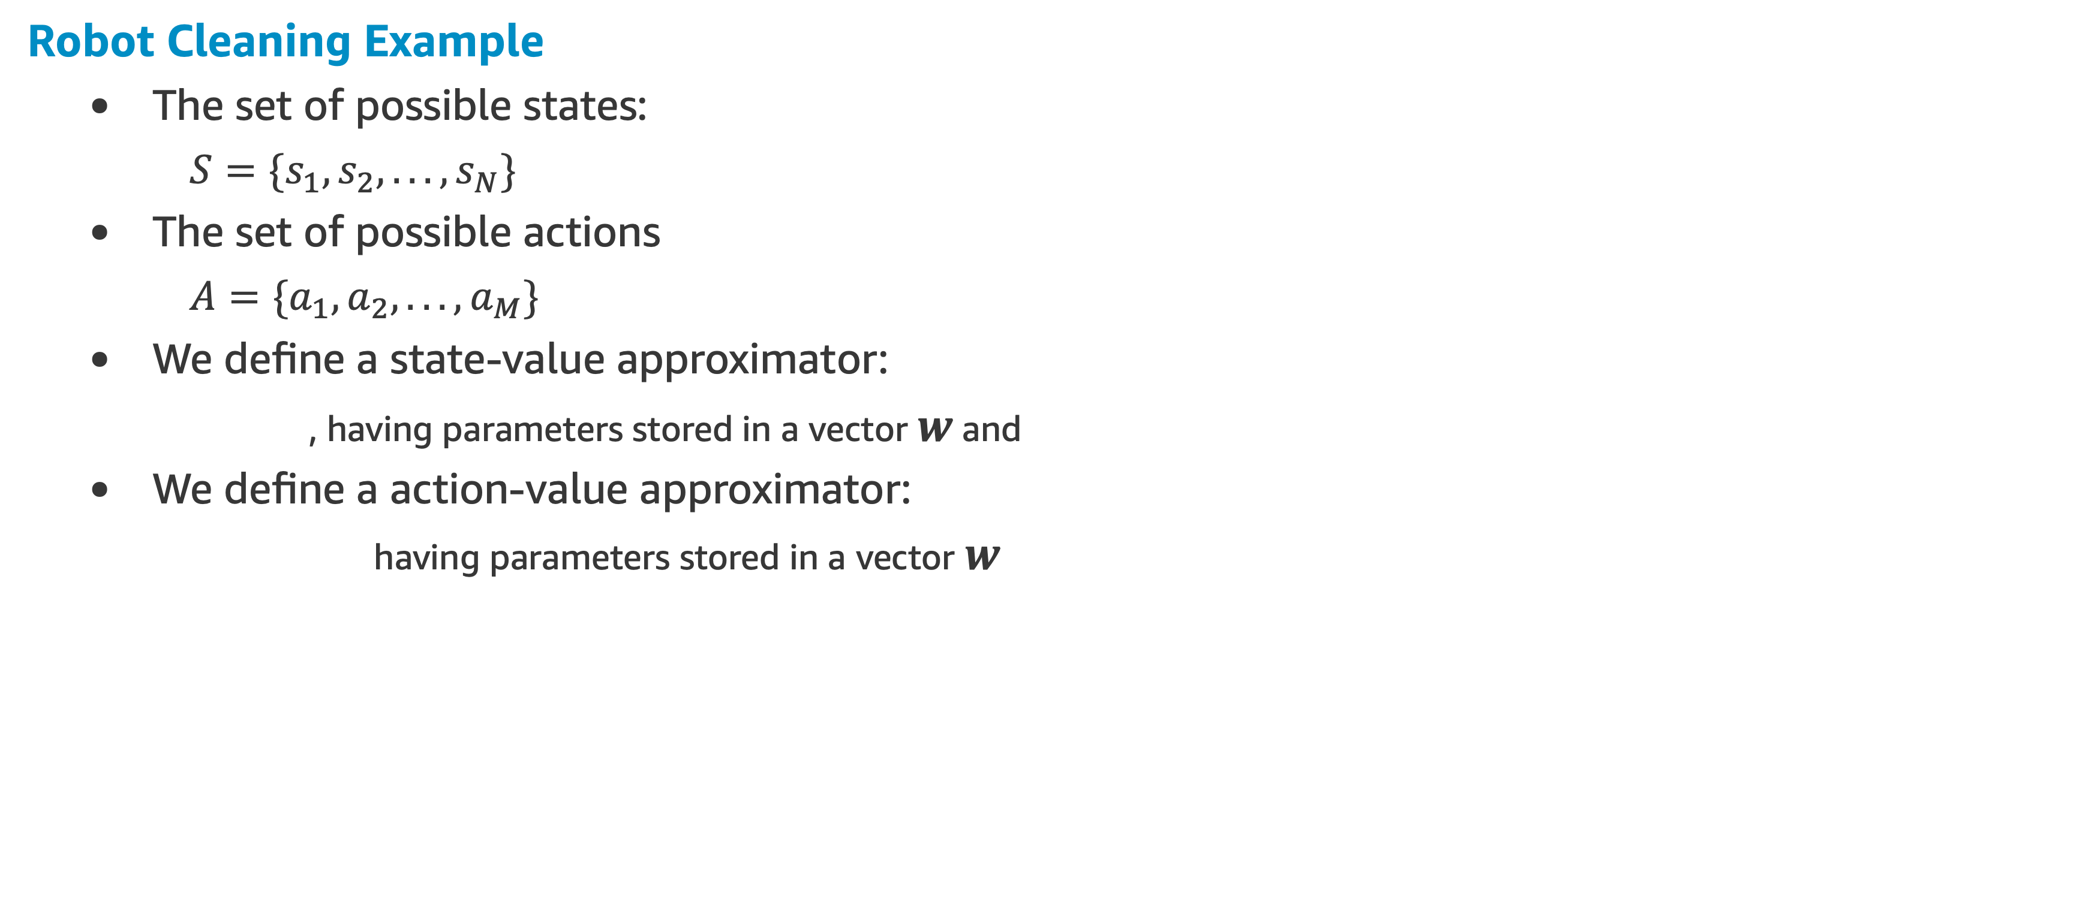
Function Approximation Intuition
Robot Cleaning Example
The set of possible states:
$S=\{s_{1},s_{2},...,s_{N}\}$
The set of possible actions
$A=\{a_{1},a_{2},...,a_{M}\}$
We define a state-value approximator:
, having parameters stored in a vector $w$ and
We define a action-value approximator:
having parameters stored in a vector $w$

Slide 15
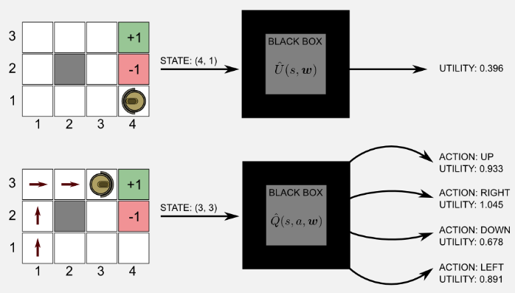
Function Approximation Intuition
Robot Cleaning Example
Imagine function approximator as a black box:
The black box takes as input the current state and returns the value of the state or the state-action values
The main advantage is that we can approximate (with an arbitrary small error) the values using less parameters respect to the tabular approach
We can say that the number of elements stored in the vector w is smaller than N, the number of values in the tabular counterpart

Slide 16
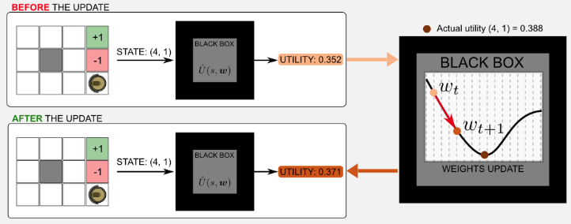
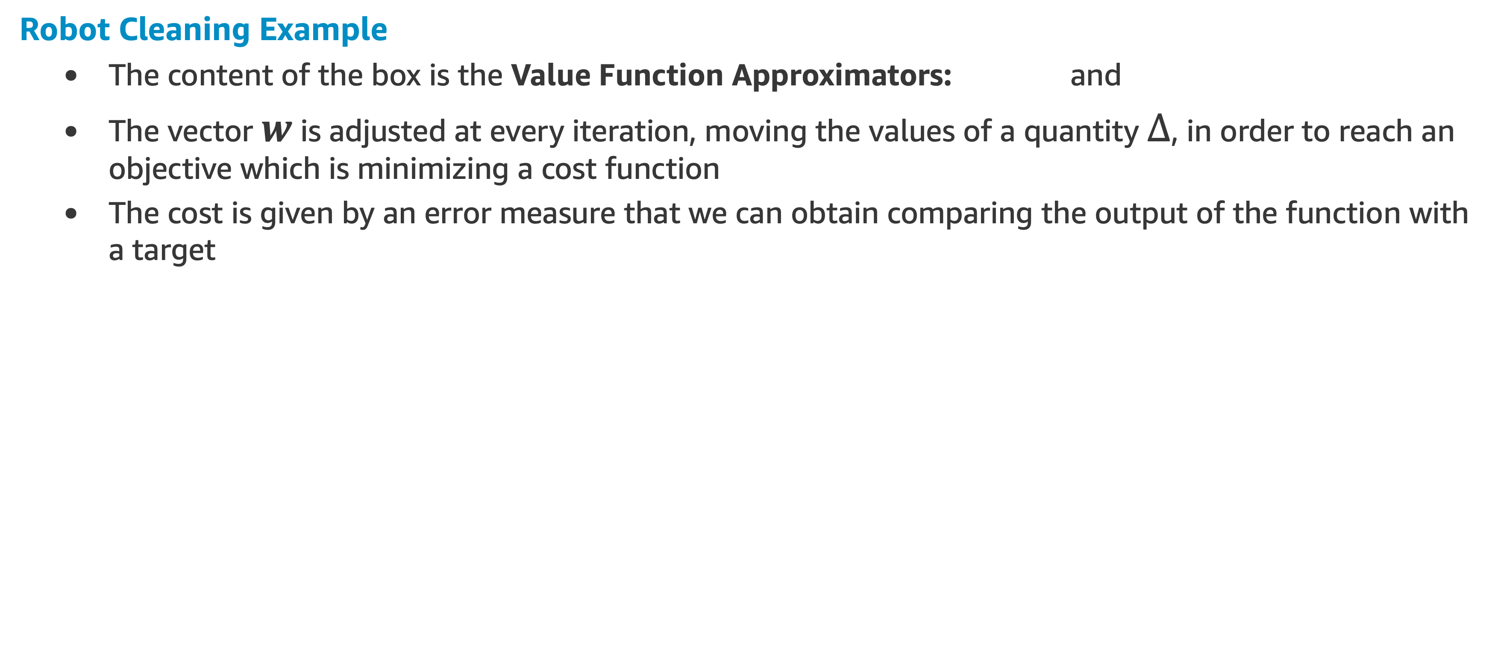
Function Approximation Intuition
Robot Cleaning Example
The content of the box is the Value Function Approximators: and
The vector $w$ is adjusted at every iteration, moving the values of a quantity $Δ$, in order to reach an objective which is minimizing a cost function
The cost is given by an error measure that we can obtain comparing the output of the function with a target

Slide 17
Function Approximation Intuition
Robot Cleaning Example
The actual state-value of state (4,1) in our gridworld is 0.388
Let’s say that at time t the output of the box is 0.352
After the update step, the output will be 0.371, we moved closer to the target value

Slide 18
Value Function Approximation

Slide 19
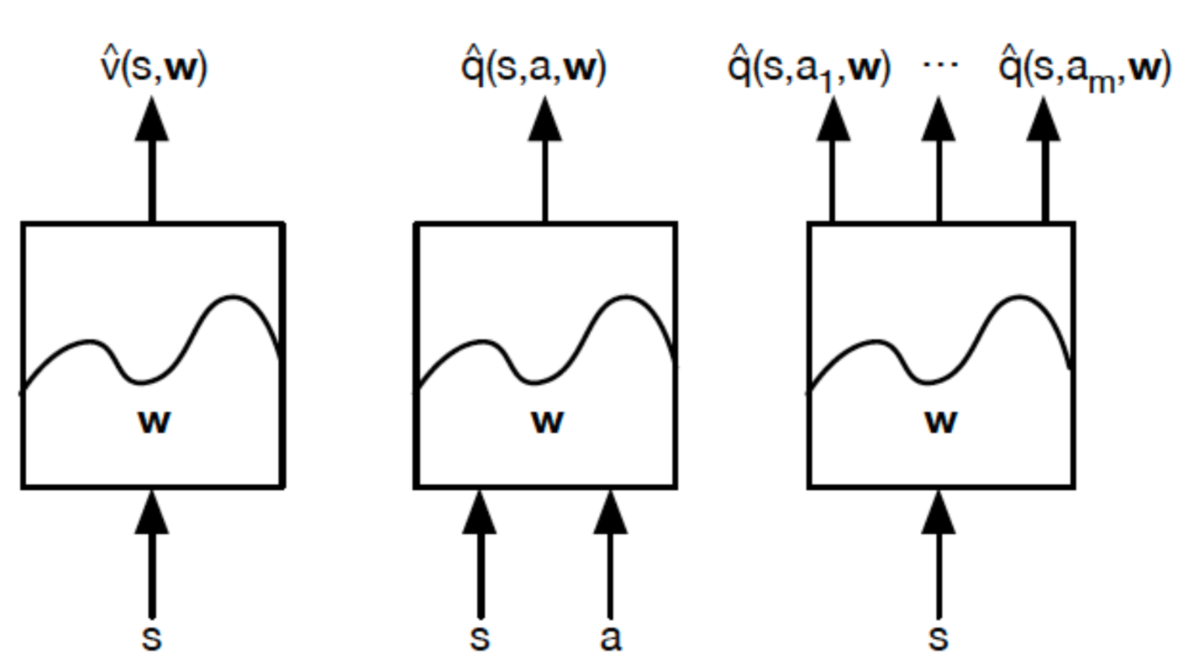
Types of Value Function Approximation

Slide 20
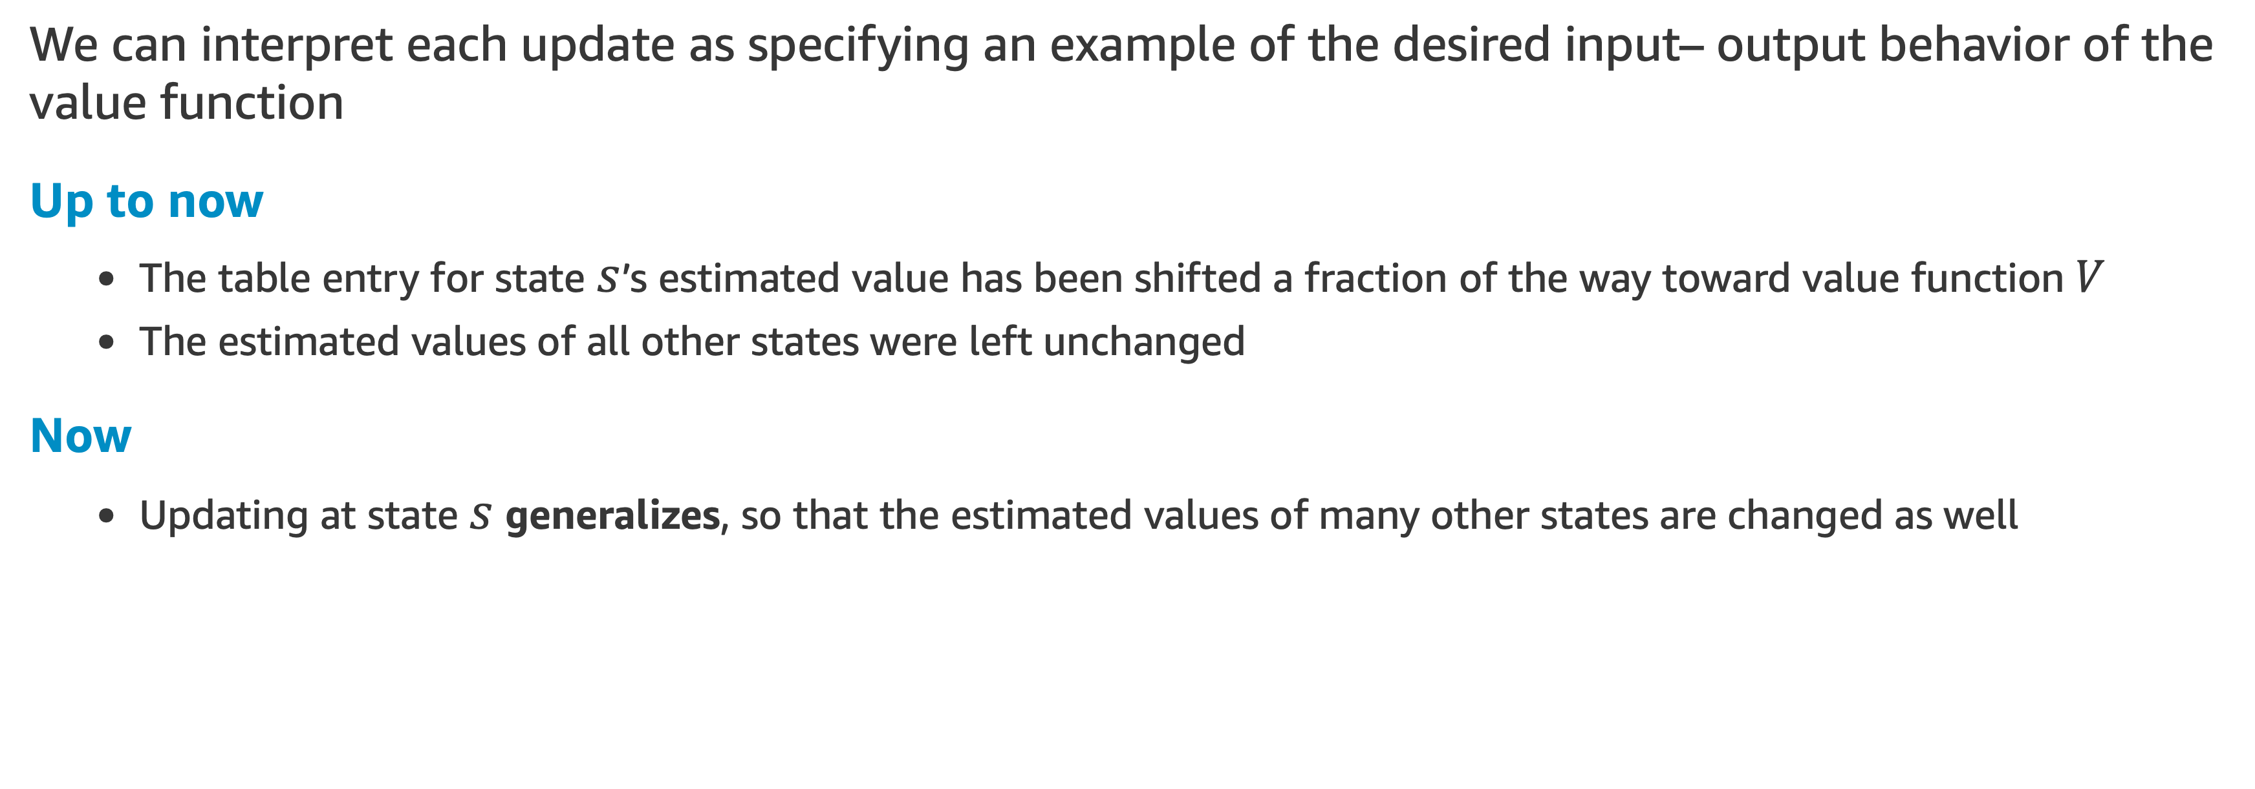
Value Function Approximation
We can interpret each update as specifying an example of the desired input– output behavior of the value function
Up to now
The table entry for state $s$’s estimated value has been shifted a fraction of the way toward value function $V$
The estimated values of all other states were left unchanged
Now
Updating at state $s$ generalizes, so that the estimated values of many other states are changed as well

Slide 21
Value Function Approximation
Function Approximation
Machine learning methods that learn to mimic input–output examples in this way are called supervised learning methods
For numerical outputs, the process is often called function approximation
We can use any method for supervised learning, including artificial neural networks, decision trees, and various kinds of multivariate regression
In reinforcement learning, it is important that learning be able to occur online, while the agent interacts with its environment or with a model of its environment

Slide 22
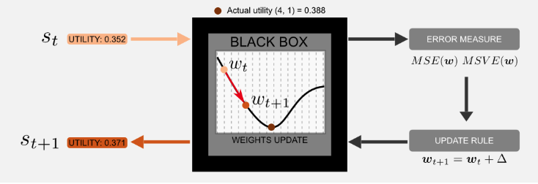
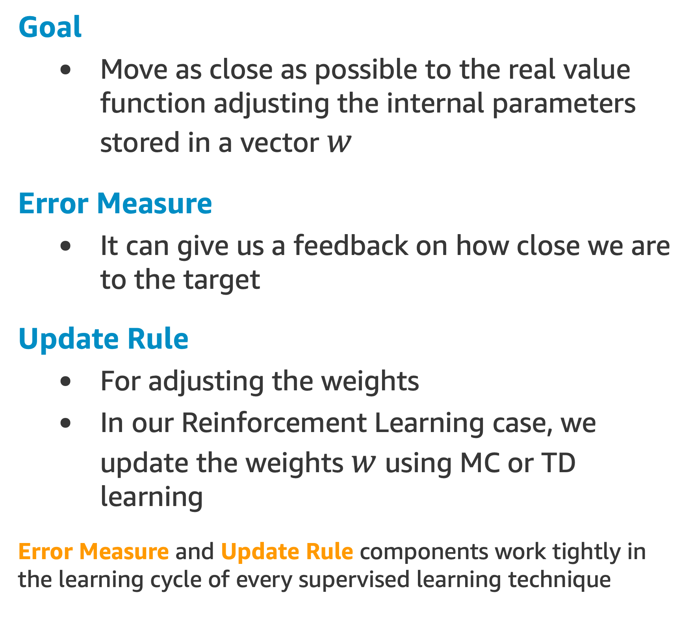
Value Function Approximation
Goal
Move as close as possible to the real value function adjusting the internal parameters stored in a vector $w$
Error Measure
It can give us a feedback on how close we are to the target
Update Rule
For adjusting the weights
In our Reinforcement Learning case, we update the weights $w$ using MC or TD learning
Error Measure and Update Rule components work tightly in the learning cycle of every supervised learning technique

Slide 23
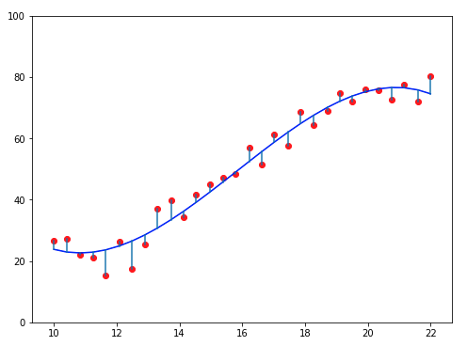
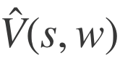
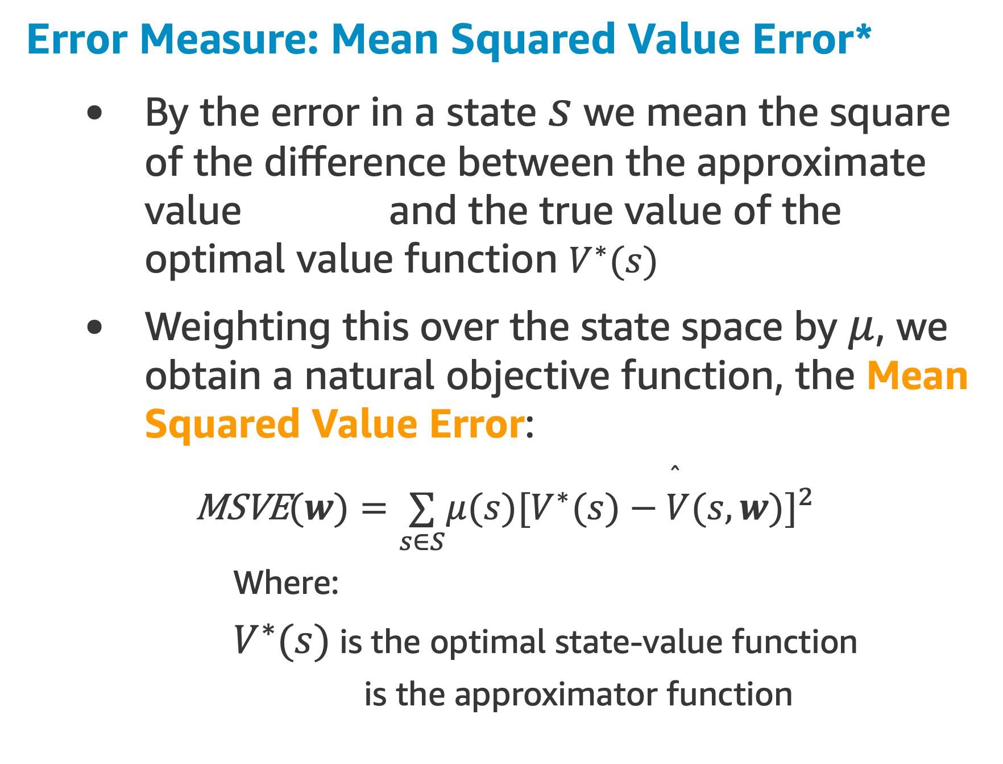
Value Function Approximation
Error Measure: Mean Squared Value Error*
By the error in a state $s$ we mean the square of the difference between the approximate value and the true value of the optimal value function $V^{∗}(s)$
Weighting this over the state space by $μ$, we obtain a natural objective function, the Mean Squared Value Error:
$\text{MSVE}(w)=\underset{s∈S}{∑}μ(s)[V^{∗}(s)−\overset{̂}{V}(s,w)]^{2}$
Where:
$V^{∗}(s)$ is the optimal state-value function
is the approximator function
* This is a reinterpretation of the MSE, the common lost function used in supervised learning

Slide 24
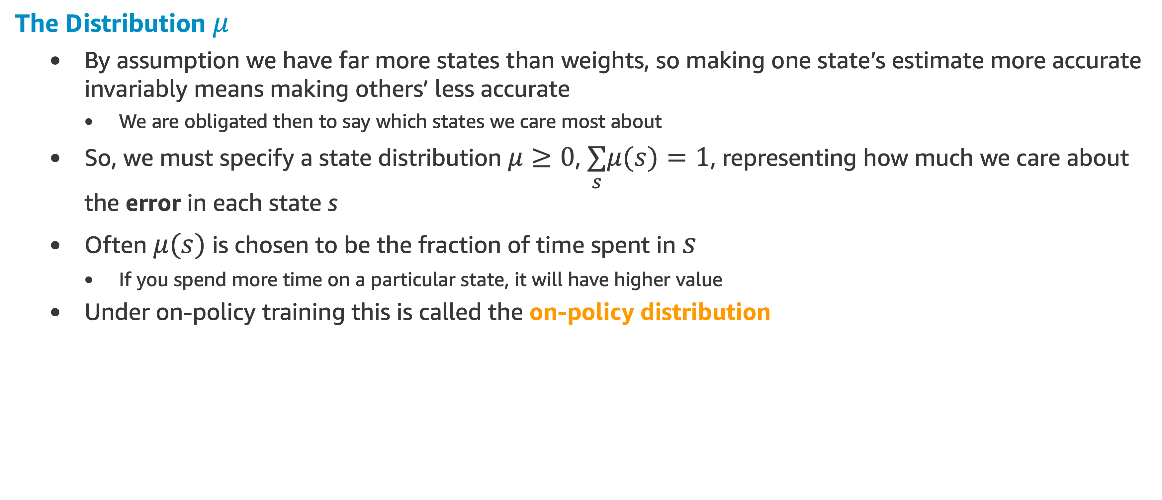
Value Function Approximation
The Distribution $μ$
By assumption we have far more states than weights, so making one state’s estimate more accurate invariably means making others’ less accurate
We are obligated then to say which states we care most about
So, we must specify a state distribution $μ≥0$, $\underset{s}{∑}μ(s)=1$, representing how much we care about the error in each state s
Often $μ(s)$ is chosen to be the fraction of time spent in $s$
If you spend more time on a particular state, it will have higher value
Under on-policy training this is called the on-policy distribution

Slide 25
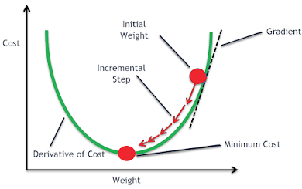
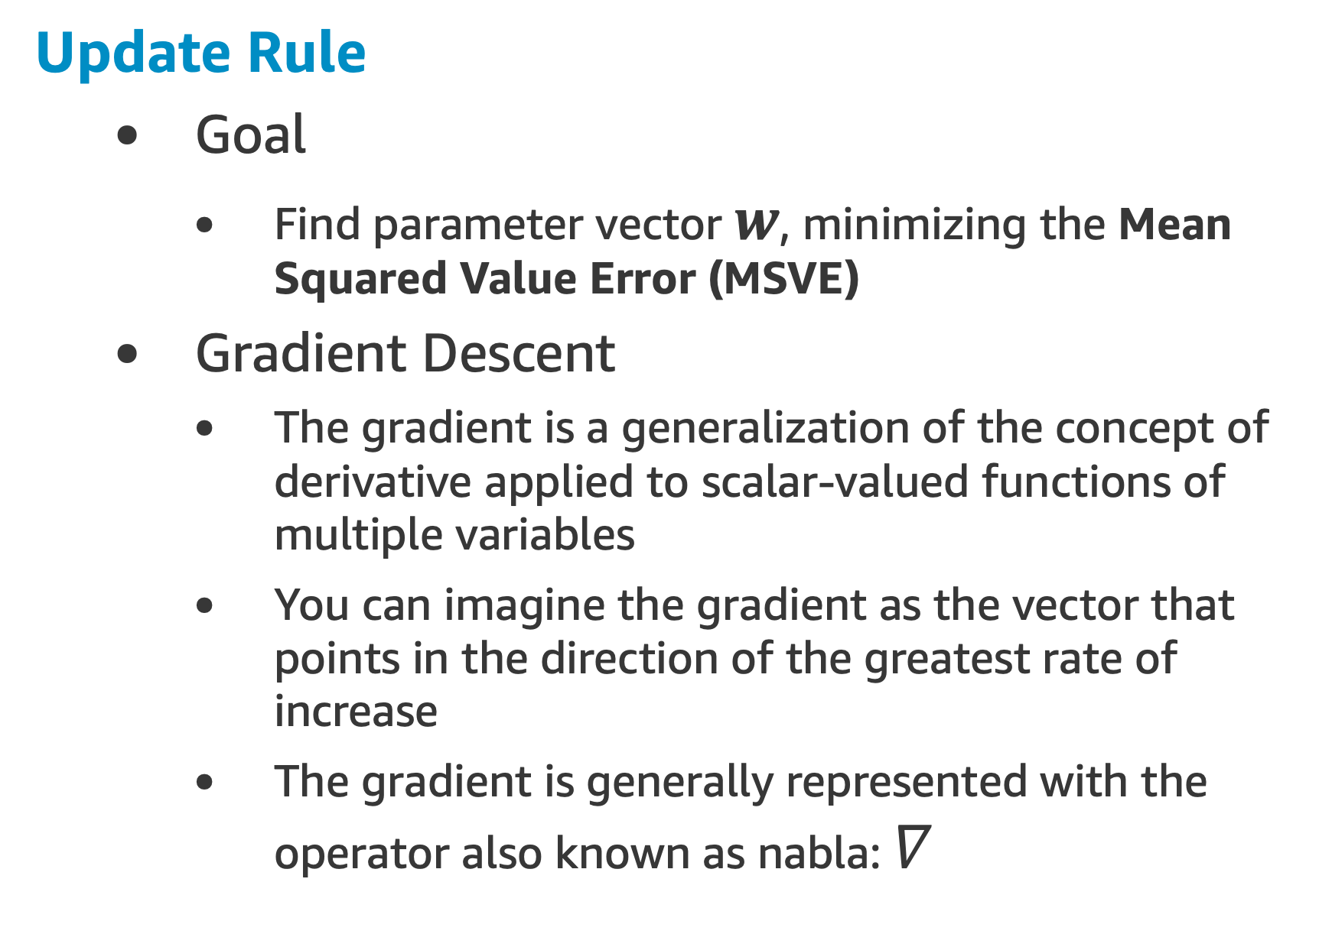
Value Function Approximation
Update Rule
Goal
Find parameter vector $w$, minimizing the Mean Squared Value Error (MSVE)
Gradient Descent
The gradient is a generalization of the concept of derivative applied to scalar-valued functions of multiple variables
You can imagine the gradient as the vector that points in the direction of the greatest rate of increase
The gradient is generally represented with the operator also known as nabla: $∇$

Slide 26
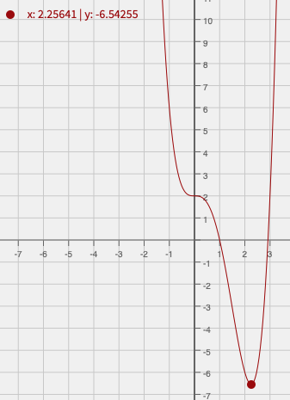
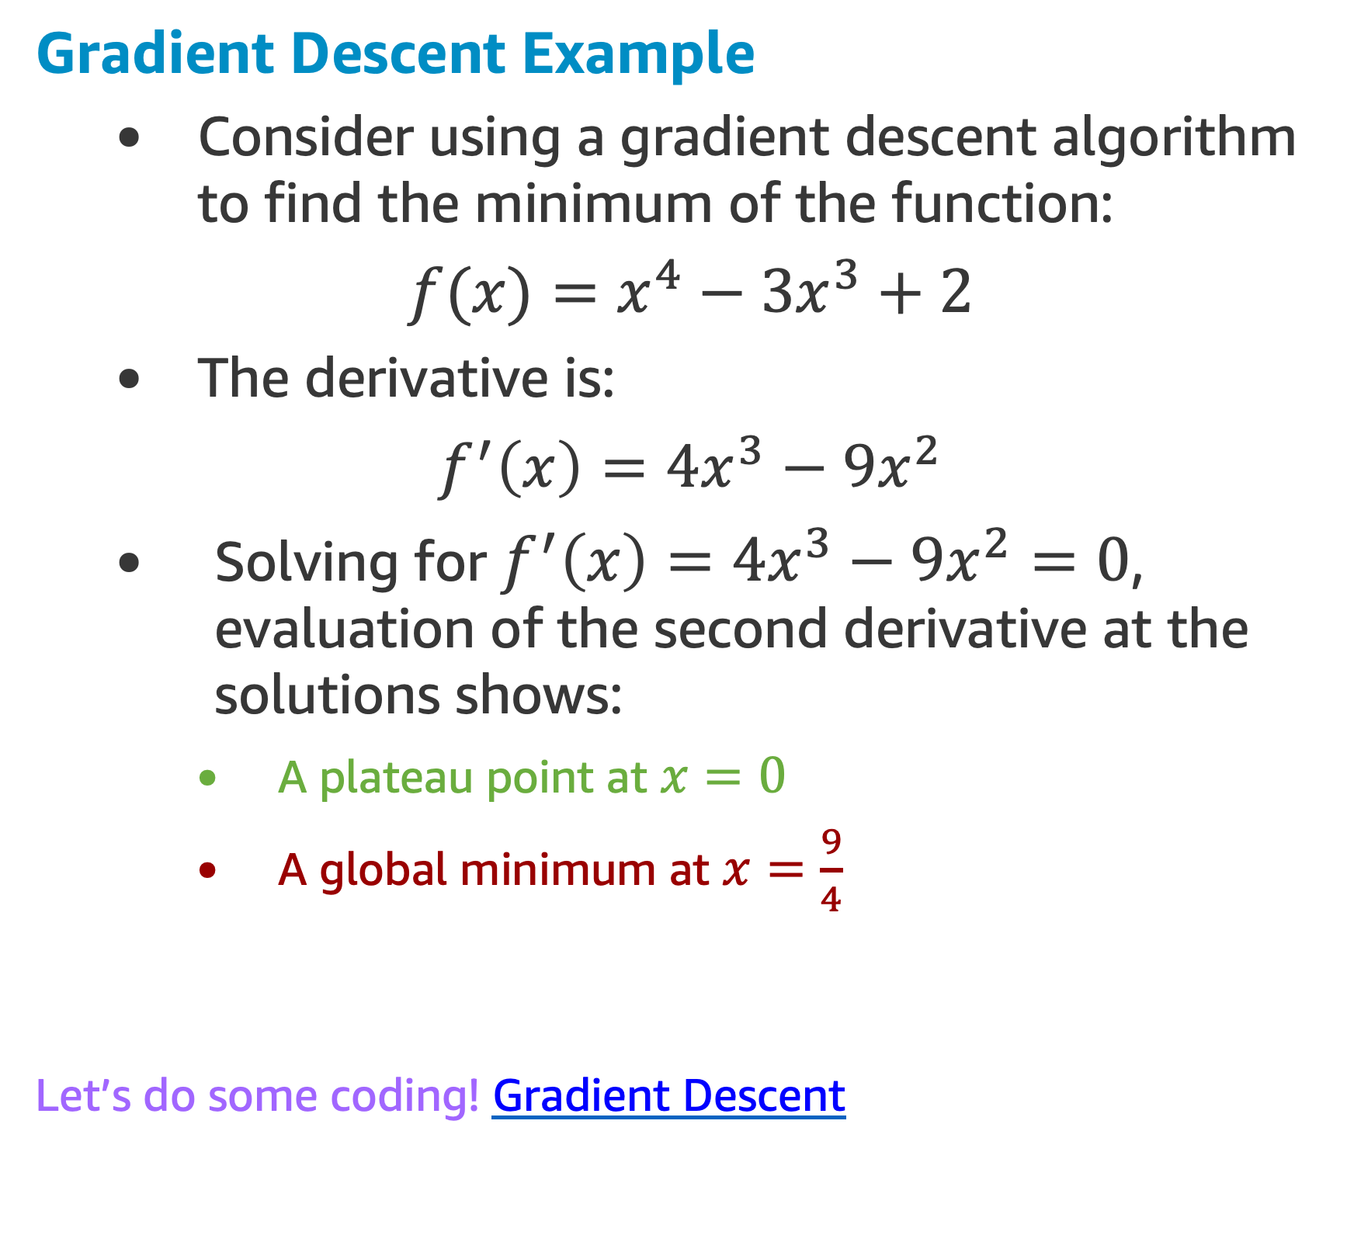
Value Function Approximation
Gradient Descent Example
Consider using a gradient descent algorithm to find the minimum of the function:
$f(x)=x^{4}−3x^{3}+2$
The derivative is:
$f^{′}\left(x\right)=4x^{3}−9x^{2}$
Solving for $f^{′}\left(x\right)=4x^{3}−9x^{2}=0$, evaluation of the second derivative at the solutions shows:
A plateau point at $x=0$
A global minimum at $x=\frac{9}{4}$
Let’s do some coding! Gradient Descent

Slide 27
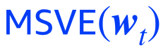
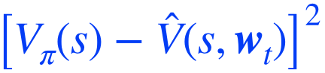
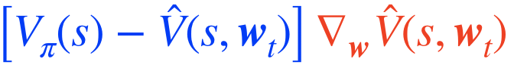
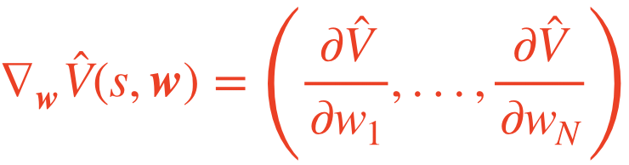
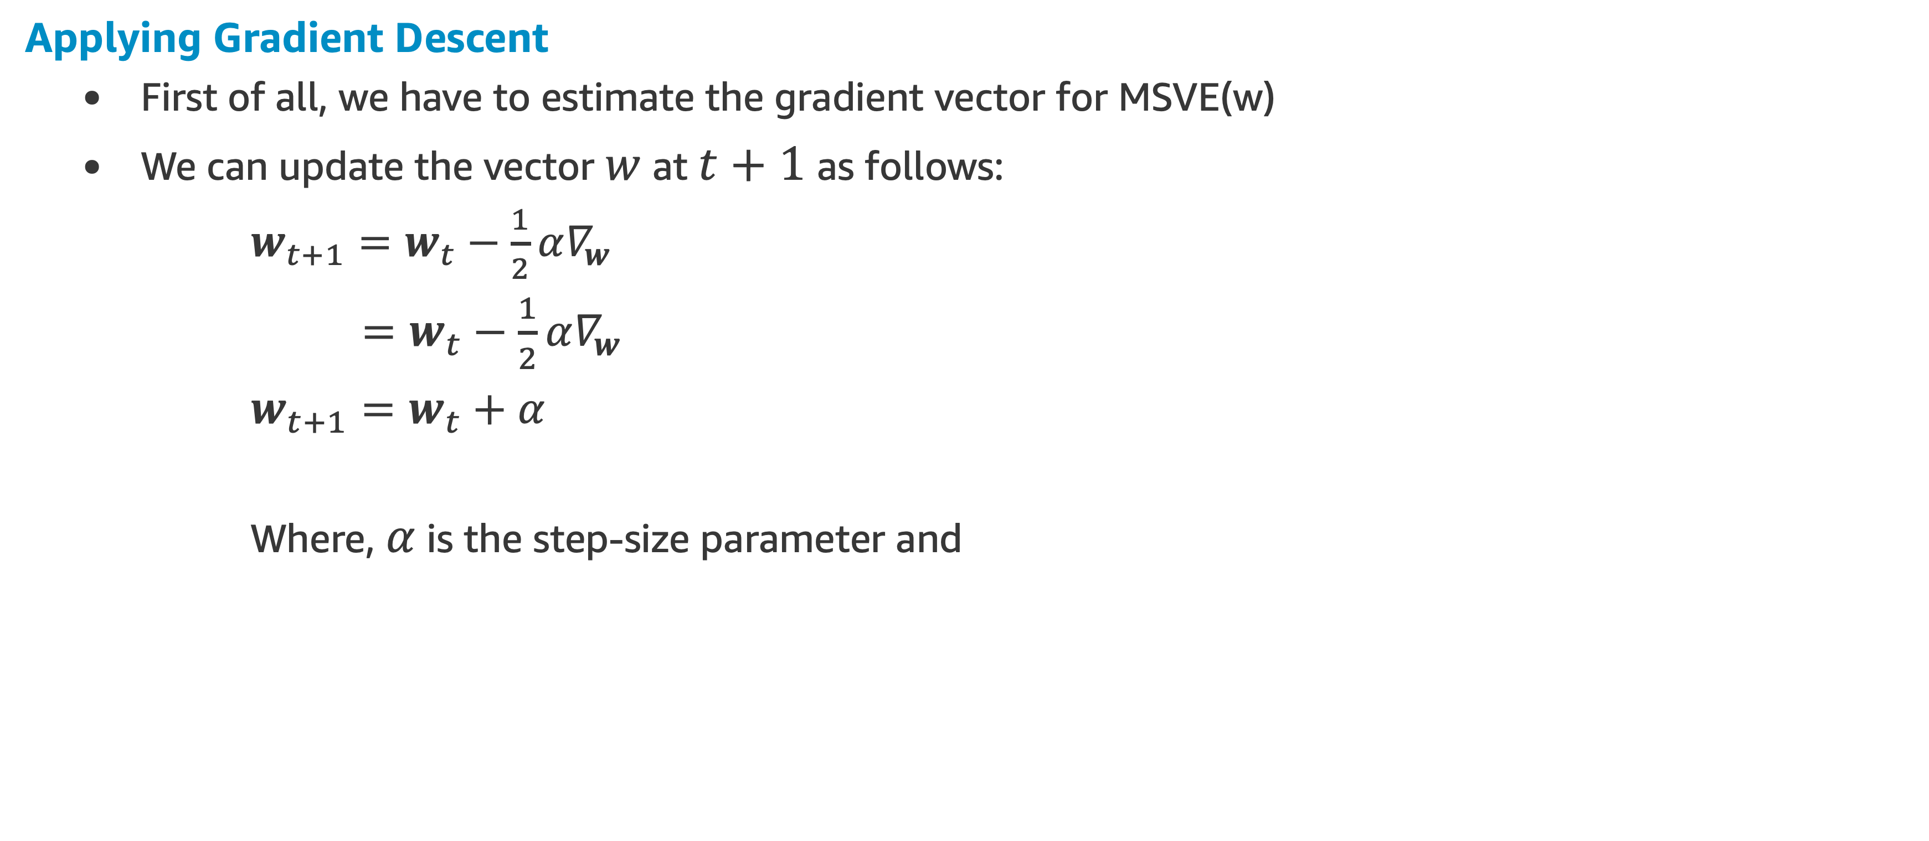
Value Function Approximation
Applying Gradient Descent
First of all, we have to estimate the gradient vector for MSVE(w)
We can update the vector $w$ at $t+1$ as follows:
$w_{t+1}=w_{t}−\frac{1}{2}α∇_{w}$
$=w_{t}−\frac{1}{2}α∇_{w}$
$w_{t+1}=w_{t}+α$
Where, $α$ is the step-size parameter and

Slide 28
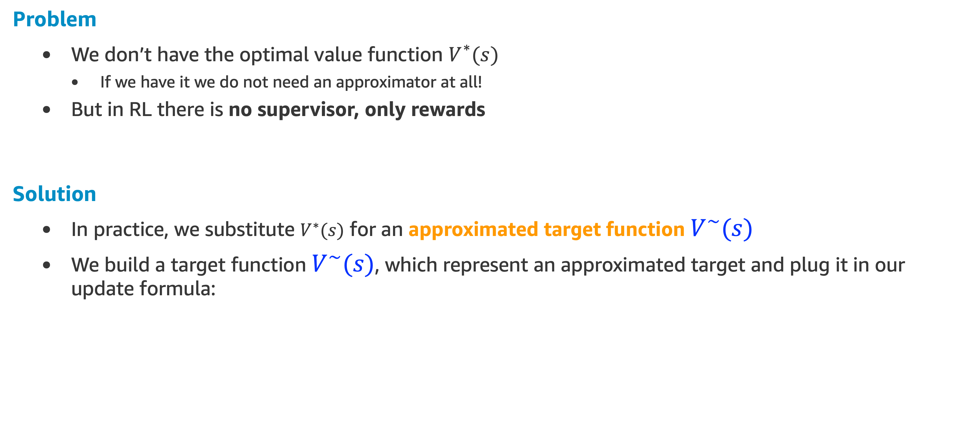
Estimating the Target
Problem
We don’t have the optimal value function$V^{∗}(s)$
If we have it we do not need an approximator at all!
But in RL there is no supervisor, only rewards
Solution
In practice, we substitute $V^{∗}(s)$for an approximated target function $V^{∼}(s)$
We build a target function $V^{∼}(s)$, which represent an approximated target and plug it in our update formula:

Slide 29
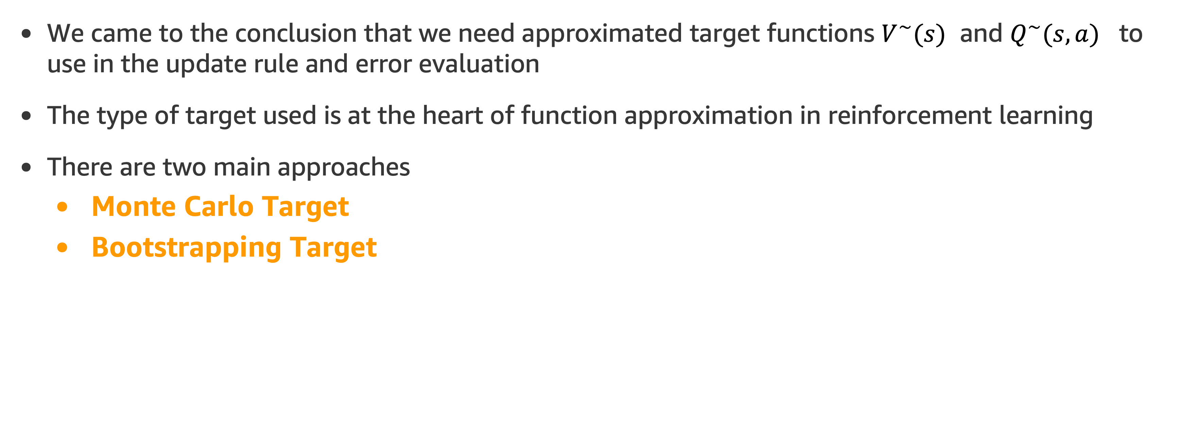
Value Function Approximation
We came to the conclusion that we need approximated target functions $V^{∼}(s)$ and $Q^{∼}(s,a)$ to use in the update rule and error evaluation
The type of target used is at the heart of function approximation in reinforcement learning
There are two main approaches
Monte Carlo Target
Bootstrapping Target

Slide 30
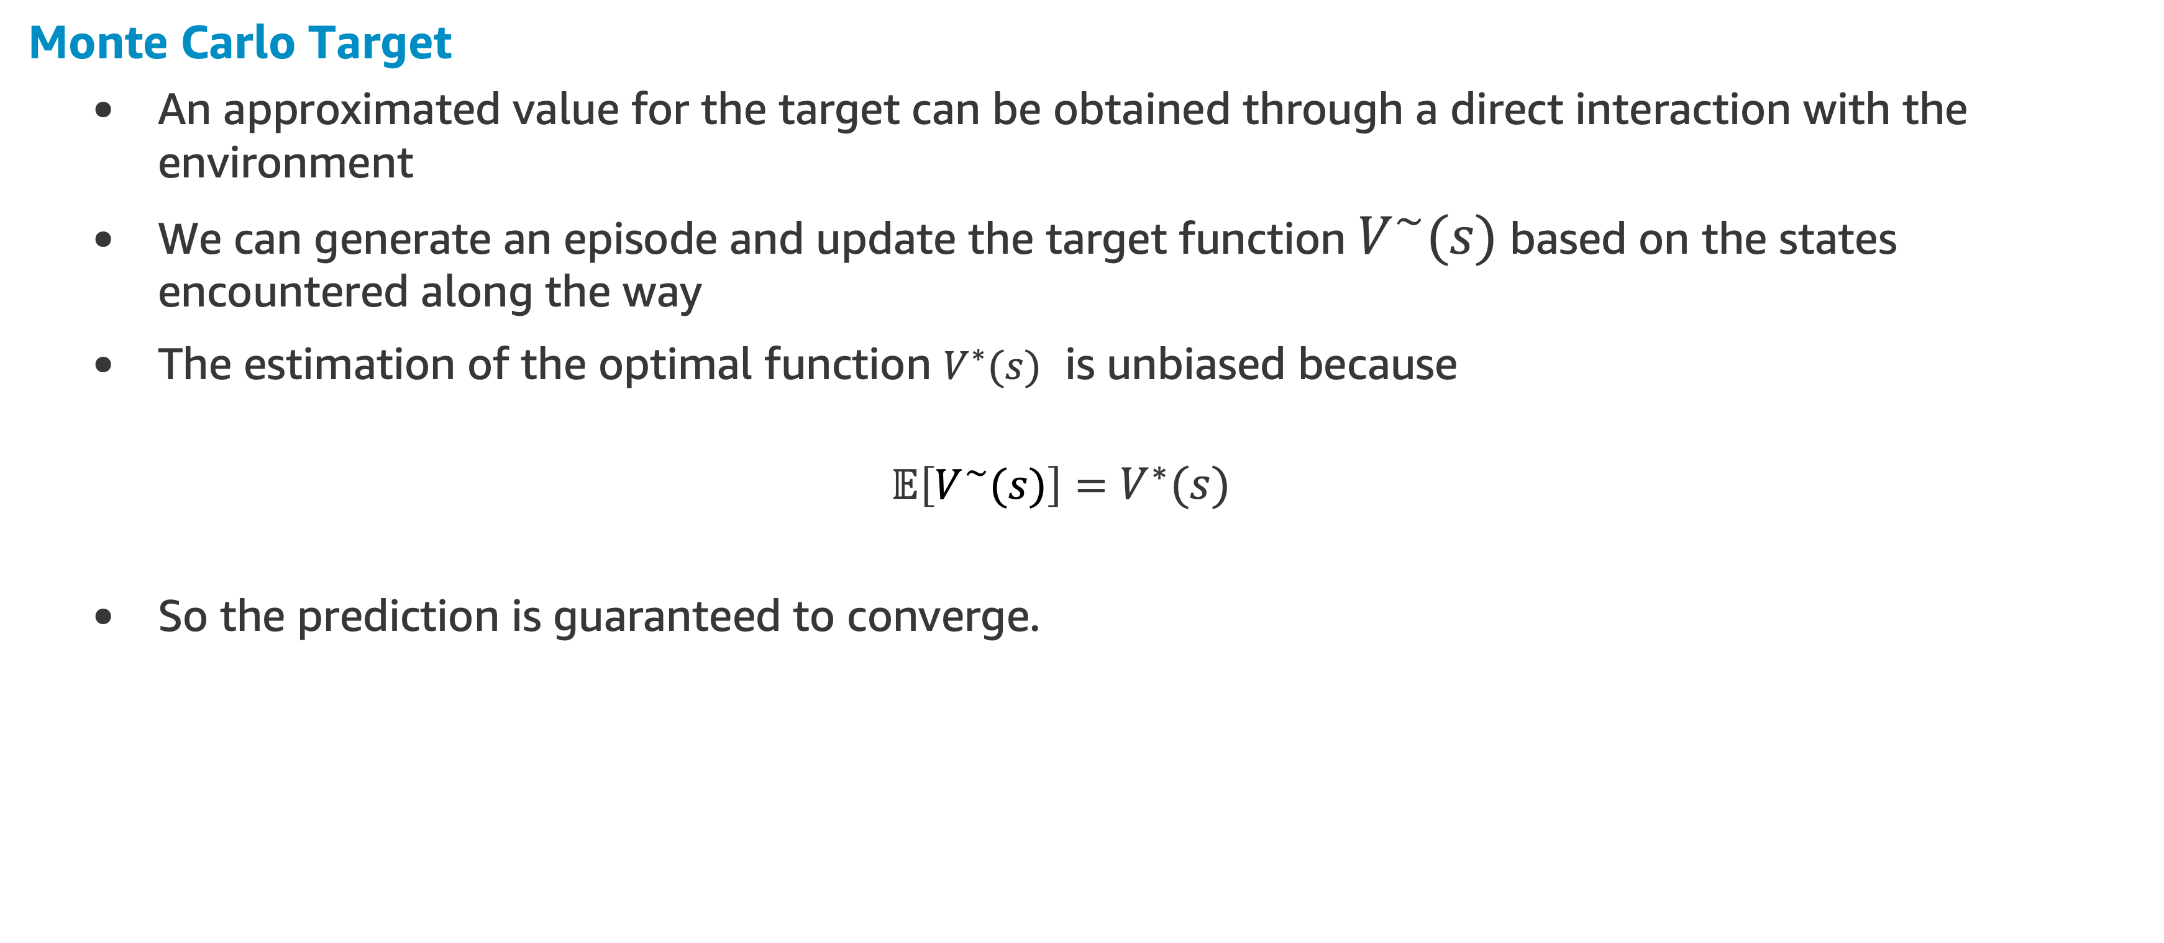
Value Function Approximation
Monte Carlo Target
An approximated value for the target can be obtained through a direct interaction with the environment
We can generate an episode and update the target function $V^{∼}(s)$ based on the states encountered along the way
The estimation of the optimal function $V^{∗}(s)$ is unbiased because
$$𝔼\left[V^{∼}(s)\right]=V^{∗}(s)$$
So the prediction is guaranteed to converge.

Slide 31
Value Function Approximation
Bootstrapping Target
We do not have to complete an episode for getting an estimation of the target
We can directly update the approximator parameters after each visit
The simplest form of bootstrapping target is the one based on TD(0):
We are going to explore both for the simpler case of a linear approximator

Slide 32
Linear & High-Order Approximators

Slide 33
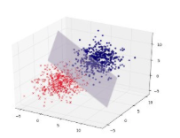
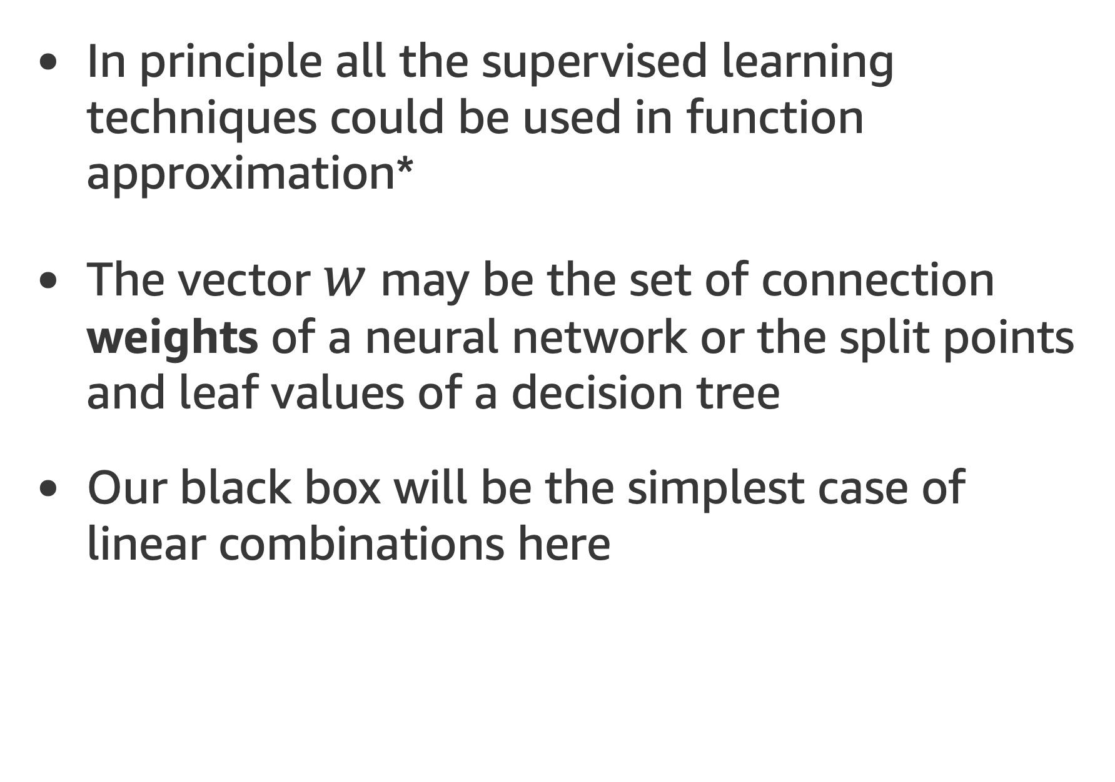
Linear Approximator
In principle all the supervised learning techniques could be used in function approximation*
The vector $w$ may be the set of connection weights of a neural network or the split points and leaf values of a decision tree
Our black box will be the simplest case of linear combinations here
* More sophisticated methods like Radial basis functions and neural networks are out of the scope of this course

Slide 34
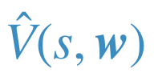
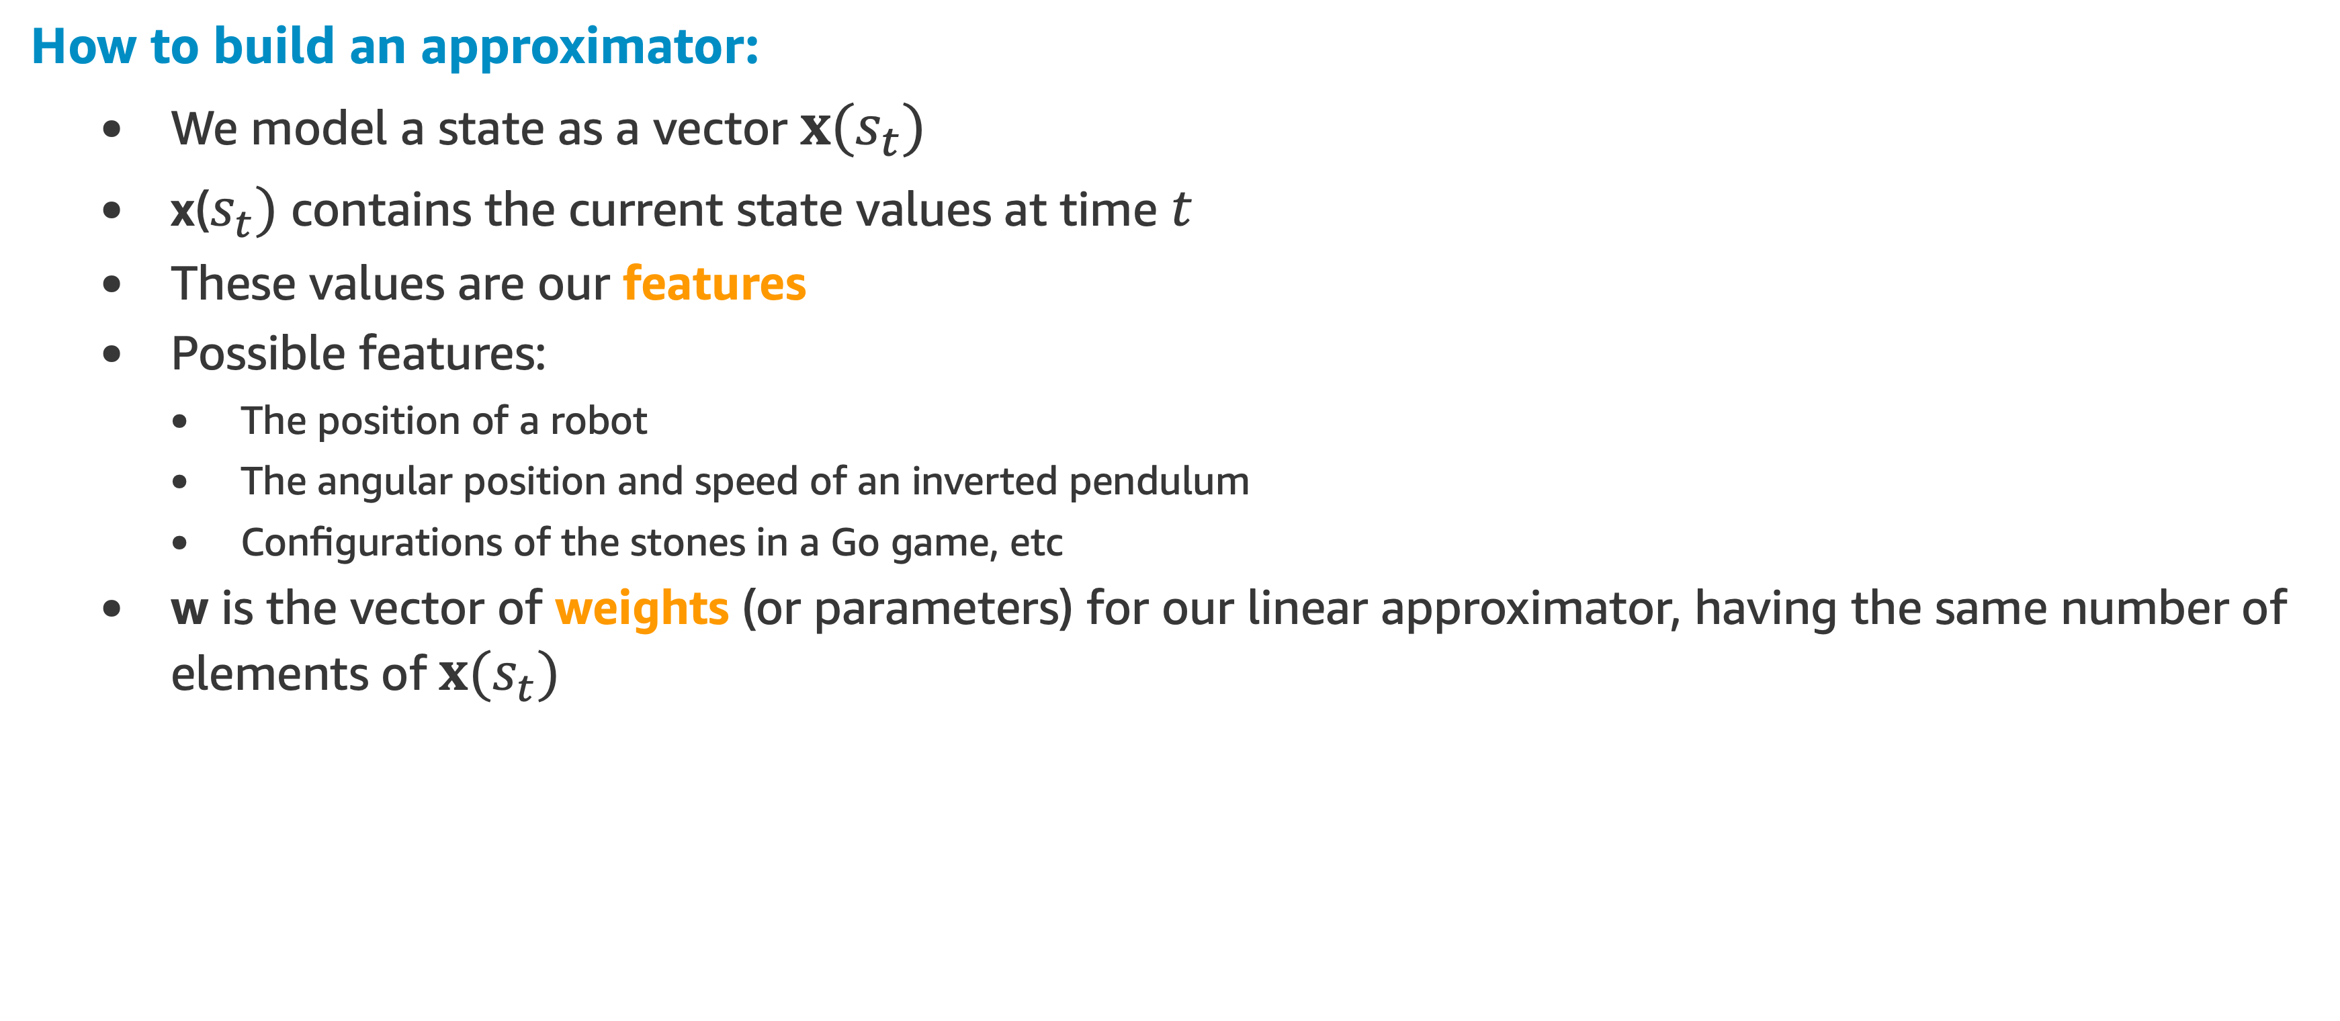
Linear Approximator
How to build an approximator:
We model a state as a vector $x(s_{t})$
x($s_{t})$ contains the current state values at time $t$
These values are our features
Possible features:
The position of a robot
The angular position and speed of an inverted pendulum
Configurations of the stones in a Go game, etc
w is the vector of weights (or parameters) for our linear approximator, having the same number of elements of $x(s_{t})$

Slide 35
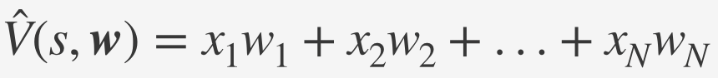
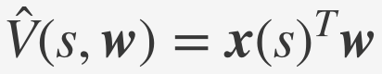
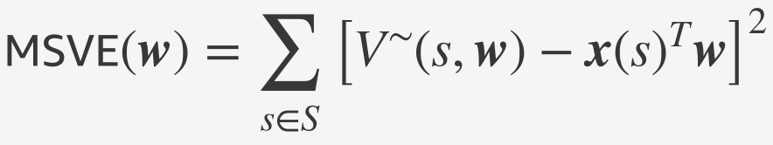
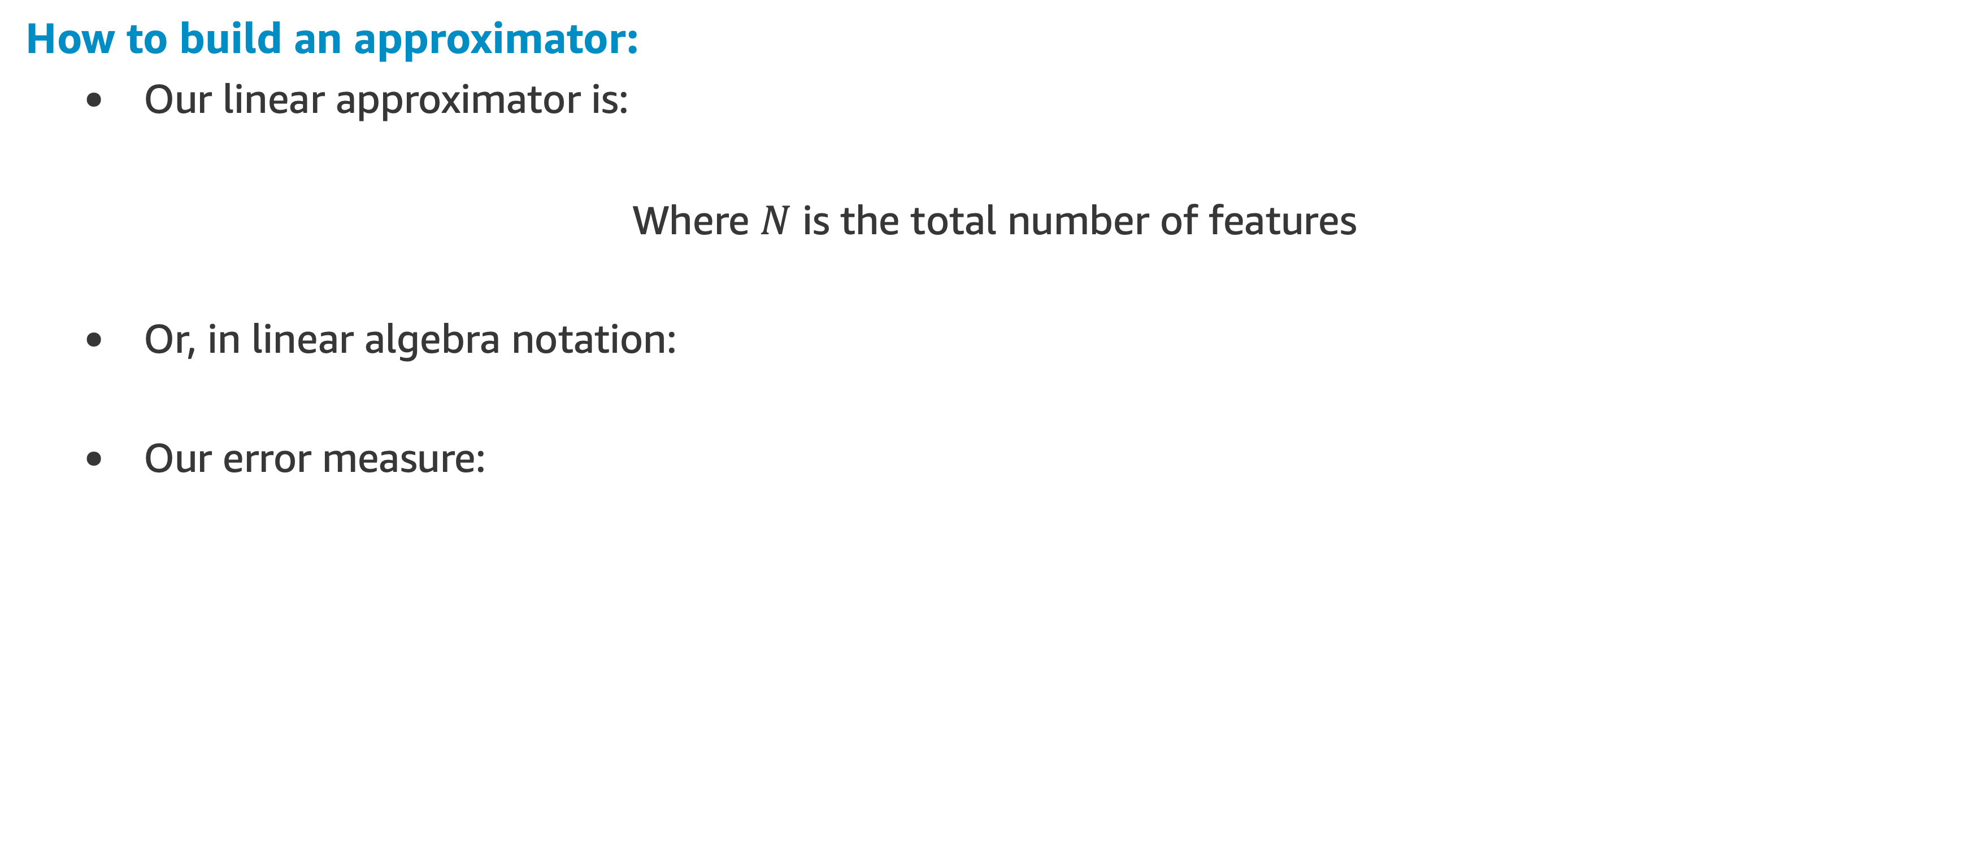
Linear Approximator
How to build an approximator:
Our linear approximator is:
Where $N$ is the total number of features
Or, in linear algebra notation:
Our error measure:

Slide 36
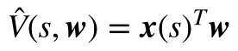
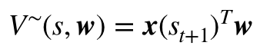
Linear Approximator
Putting Everything Together
From our general update rule:
Using our linear approximator:
And defining the target from TD(0) as follows:
We can define the update rule, just introducing the reward and the discount factor:

Slide 37
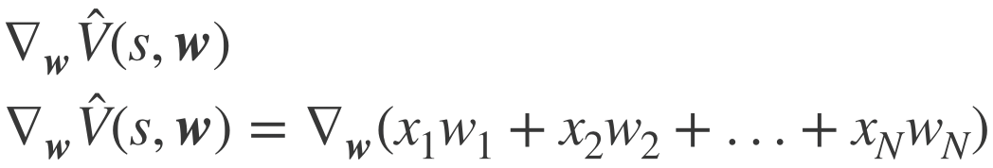
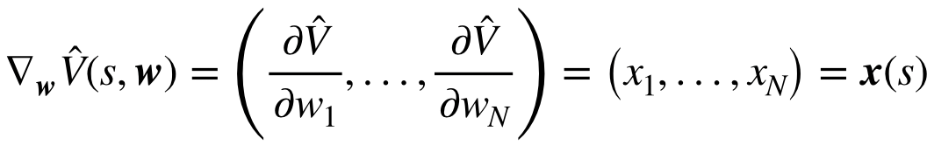
Linear Approximator
How to build an approximator:
The last piece:
The Gradient
Rewriting the update rule:
Update = step-size x prediction error x feature value

Slide 38
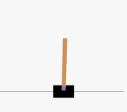
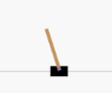
High-order Approximators
Limitations of Linear Approximators
The linear case is appealing not only for its simplicity but also because it is guaranteed to converge
However, it cannot represent complex relationships (interactions) between features!
And they happens a lot in physical systems
Example:
The inverted pendulum angular position and velocity are tightly connected
A high angular velocity may be either good or bad depending on the position of the pole

Slide 39
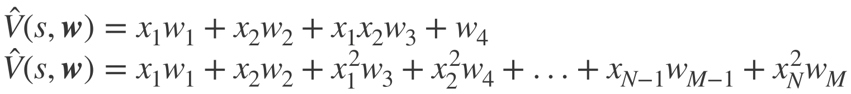
High-order Approximators
Examples
Choosing the right set of polynomials is not easy!
The bias-variance tradeoff
A simple approximator like the linear one can miss the relevant relations between features and target, whereas a high order approximator can fail to generalize to new unseen states

Slide 40
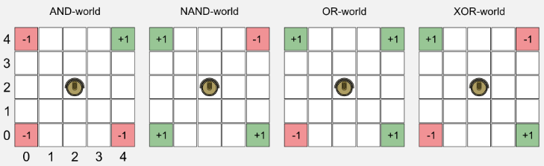
Linear Approximator Example
Robot Boolean Gridworld (and the bias)
A square gridworld where charging stations (green cells) and stairs (red cells) are disposed in multiple locations
The position of the positive and negative cells can vary giving rise to four worlds which are called: OR-world, AND-world, NAND-world, XOR-world
The robot has four action available: forward, backward, left, right
When an action is performed, with a probability of 0.2 it can lead to a wrong movement
The reward is positive (+1.0) for green cells, negative (-1.0) for red cells, and null in all the other cases

Slide 41
Linear Approximator Example
Robot Boolean Gridworld (and the bias)
It’s called Boolean Gridworld because its patterns represents basic Boolean operations
X | Y | AND | NAND | OR | XOR
0 | 0 | 0 | 1 | 0 | 0
1 | 0 | 0 | 1 | 1 | 1
0 | 1 | 0 | 1 | 1 | 1
1 | 1 | 1 | 0 | 1 | 0

Slide 42
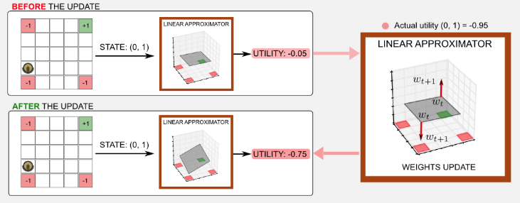
Linear Approximator Example
Robot Boolean Gridworld (and the bias)
A linear approximator to the boolean worlds, try to find a plane in a three-dimensional space which can discriminate between states with high utility (green cells) and states with low utility (red cells)

Slide 43
Linear Approximator Example
Robot Boolean Gridworld (and the bias)
In the three-dimensional space:
The x-axis is represented by the columns of the world
The y-axis is represented by the rows
The state-value is given by the z-axis

Slide 44
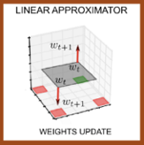

Linear Approximator Example
Robot Boolean Gridworld (and the bias)
During the gradient descent we are changing the weights, adjusting the inclination of the plane and the state-values associated to each state
By changing the coefficients associated to $x$ and $y$ you are changing the weights associated to those features and you are in fact moving the plane: $z=x+y$
The surface of the plane is the state-value returned by the linear approximator. The utility should be -1 in proximity of a red cell, and +1 in proximity of a green cell

Slide 45


Linear Approximator Example
Robot Boolean Gridworld (and the bias)
In assignment 3 you will implement this solution and will deal with two difficulties:
For the AND and NAND world we seem to have a problem that can be solved using a bias term
Still, the XOR world have another kind of problem that can be solved using a polynomial approach
You will learn about that in the assignment!

Slide 46
Generalization

Slide 47
Almost There for Function Approximation …
So far we have explored a discrete space using the Boolean Gridworld
But, most RL real problems have a continuous space environment
Now we are going to explore two methods with approximation for continuous space:
We will introduce the important concept of generalization
We will implement MC learning and TD(0) learning
We are going to use both to solve the classic Mountain Car problem

Slide 48
The Idea of Generalization
For discrete state space, theoretically an agent is able to experience every state and explore rewards on each of them
With the case being extended to continuous state space, to generalize the value function, we will need a representation of state
Here the idea of supervised learning applies also, as we have seen for the linear approximation in the discrete Boolean gridworld example
We are going to introduce the concepts of state aggregation and tile coding, related to generalization

Slide 49

The Idea of Generalization
State Aggregation
It is the simplest form of function approximation for continuous space
Suppose that we have a continuous state space in the range [1,10]
We define the value functions as:
V$(s)=w_{0, }if1≤s≤5$
V$\left(s\right)=w_{1}, if5<s≤10$
The advantage of state aggregation is that the derivative for state in each aggregated session is 1 and the value for that state is the corresponding weight

Slide 50

The Mountain Car Problem
The goal is to drive up the mountain on the right
The only way to succeed is to drive back and forth to build up momentum
The car’s state, at any point in time, is given by a vector containing its horizontal position and velocity
Starting state
Stationary, at the Bottom of the valley

Slide 51


The Mountain Car Problem

Slide 52
The Mountain Car Problem
For each step that the car does not reach the goal, located at position 0.5, the environment returns a reward of -1
Each episode finishes if the car reach the goal or accumulate a sum of -200 negative rewards

Slide 53

The Mountain Car Problem
Discretization with State Aggregation
The Mountain car problem has two continue values to define a state:
Position and velocity
A simple approach is to just apply state aggregation over the state space
We set up the bins, breaking position and velocity in separated bins for each (Ex. position)

Slide 54



Monte-Carlo with Value Function Approximation
Linear Monte-Carlo Function Approximation
Recall the return function:
$G(t)=R_{t+1}+γR_{t+2}+...=\overset{∞}{\underset{t=0}{∑}}γ^{t}R(S_{t})$
The update function approximation for the linear case will be:
Monte-Carlo evaluation converges to a global optimum, even when using non-linear value function approximation

Slide 55


Monte-Carlo with Value Function Approximation
Linear MC Function Approximation Demo
State nearest to the exit and moving right
The true values is -2 (two moves to the exit)
State in Left side , moving to the right
The true value is -39 (39 steps required to reach the exit, starting from the left side with small positive velocity
Let’s do some coding! MC Approximator

Slide 56
Generalization with Tile Coding

Slide 57
Generalization with Tile Coding
Tile Coding
Probably the most practical and computationally efficient tool being used in continuous space, reinforcement learning problems
Essentially, tile coding is a representation of features in continuous state space
Tile coding in its simplest form is state aggregation

Slide 58


Generalization with Tile Coding
Tile Coding
Is a more efficient approach to discretize the state space.
Similar to state aggregation, with binary representation but using layers of offset tiles.
The offset can be symmetric or asymmetric.
It generalizes prediction to neighboring points.

Slide 59

Generalization with Tile Coding
Discretization with Tile Coding
On the graph, the state space is represented by 1 tiling
The grey area is the feature space, and the 2D grid with blue lines is our tiling
The white spot, which is our state value, can be represented as 1 for the grid it belongs to and 0 for the rest
This is state aggregation

Slide 60

Generalization with Tile Coding
Discretization with Tile Coding
On the right, the representation is extended to multiple tilings, each with different offsets
The white spot is represented by 4 different tilings, the four different grids include the white spot in each tiling
These four tiles correspond to four features that become active when the state occurs
Feature vector $x(s)$ has 4 x 4 x 4 components
All of which will be 0 except for the four corresponding to the tiles that the white spot falls within
This is state aggregation

Slide 61

Generalization with Tile Coding
Generalization
Similarity is in proportion to common tiles
It is more fine grained to define similarity than state aggregation
Multiple tilling extends the idea of state aggregation by representing a feature with multiple tiles
This extension is more powerful in the way that each state value may share some tiles and also belong to different tiles at the same time, which is the essence of generalization

Slide 62
Tiling Example
Feature Ranges x:[-1,1], y:[2, 5]
Number of Tiles 3
Bin Size 10
Offsets Tiling1:[0, 0], Tiling 2:[0.2, 1], Tiling 3:[0.4, 1.5]
Feature Sample x,y:[0.1, 4.0]
Indexes Tiling 1:[5, 6], Tiling 2:[4, 3], Tiling 3:[3, 1]
Tiling 1
Tiling 2
Tiling 3
x|y | 2.3 | 2.6 | 2.9 | 3.2 | 3.5 | 3.8 | 4.1 | 4.4 | 4.7
-0.8 | 0 | 0 | 0 | 0 | 0 | 0 | 0 | 0 | 0
-0.6 | 0 | 0 | 0 | 0 | 0 | 0 | 0 | 0 | 0
-0.4 | 0 | 0 | 0 | 0 | 0 | 0 | 0 | 0 | 0
-0.2 | 0 | 0 | 0 | 0 | 0 | 0 | 0 | 0 | 0
0.0 | 0 | 0 | 0 | 0 | 0 | 1 | 0 | 0 | 0
0.2 | 0 | 0 | 0 | 0 | 0 | 0 | 0 | 0 | 0
0.4 | 0 | 0 | 0 | 0 | 0 | 0 | 0 | 0 | 0
0.6 | 0 | 0 | 0 | 0 | 0 | 0 | 0 | 0 | 0
0.8 | 0 | 0 | 0 | 0 | 0 | 0 | 0 | 0 | 0
offset
x|y | 3.3 | 3.6 | 3.9 | 4.2 | 4.5 | 4.8 | 5.1 | 5.4 | 5.7
-0.6 | 0 | 0 | 0 | 0 | 0 | 0 | 0 | 0 | 0
-0.4 | 0 | 0 | 0 | 0 | 0 | 0 | 0 | 0 | 0
-0.2 | 0 | 0 | 0 | 0 | 0 | 0 | 0 | 0 | 0
0.0 | 0 | 0 | 1 | 0 | 0 | 0 | 0 | 0 | 0
0.2 | 0 | 0 | 0 | 0 | 0 | 0 | 0 | 0 | 0
0.4 | 0 | 0 | 0 | 0 | 0 | 0 | 0 | 0 | 0
0.6 | 0 | 0 | 0 | 0 | 0 | 0 | 0 | 0 | 0
0.8 | 0 | 0 | 0 | 0 | 0 | 0 | 0 | 0 | 0
1.0 | 0 | 0 | 0 | 0 | 0 | 0 | 0 | 0 | 0
offset
x|y | 3.8 | 4.1 | 4.4 | 4.7 | 5.0 | 5.3 | 5.6 | 5.9 | 6.2
-0.4 | 0 | 0 | 0 | 0 | 0 | 0 | 0 | 0 | 0
-0.2 | 0 | 0 | 0 | 0 | 0 | 0 | 0 | 0 | 0
0.0 | 1 | 0 | 0 | 0 | 0 | 0 | 0 | 0 | 0
0.2 | 0 | 0 | 0 | 0 | 0 | 0 | 0 | 0 | 0
0.4 | 0 | 0 | 0 | 0 | 0 | 0 | 0 | 0 | 0
0.6 | 0 | 0 | 0 | 0 | 0 | 0 | 0 | 0 | 0
0.8 | 0 | 0 | 0 | 0 | 0 | 0 | 0 | 0 | 0
1.0 | 0 | 0 | 0 | 0 | 0 | 0 | 0 | 0 | 0
1.2 | 0 | 0 | 0 | 0 | 0 | 0 | 0 | 0 | 0
1.0
1.5
0.2
0.4
Let’s do some coding! Multiple Tiles for Multiple Features

Slide 63

TD Learning with Value Function Approximation
Linear TD(0) Learning
The update function for the linear case will be:
Linear TD(0) converges to local optimum

Slide 64
TD(0) with Value Function Approximation
Linear TD(0) Function Approximation Demo
State nearest to the exit and moving right
The true values is -2 (two moves to the exit)
State in Left side , moving to the right
The true value is -39 (39 steps required to reach the exit, starting from the left side with small positive velocity
Let’s do some coding! TD(0) Approximator

Slide 65
Action Value Function Approximation
Linear Approximation
Similar to the case for the State Value Function approximation, where:
And we have the update rule:
The action-value function can also be represented by linear combination of features:
Having:
And the update rule:

Slide 66
References

Slide 67
References

Slide 68
Assignment

Slide 69
References
Welcome to the third RL assignment
For this assignment, we are going to work with generalization: how to produce a good approximation of a large state space experiencing only a small subset, to illustrated how we can apply supervised learning instead of a lockup table.
See a more detailed explanation of the problem in the assignment notebook RL_assignment_3.ipynb, located in your student’s Sagemaker environment

